Slide 1

#56 Merge Intervals
Akhtamov Azimjon 2024299010
2025-01-09

Slide 2
Problem Definition (1)
Source: Leetcode
Title: Merge Intervals
Difficulty: medium
Type: Arrays

Slide 3
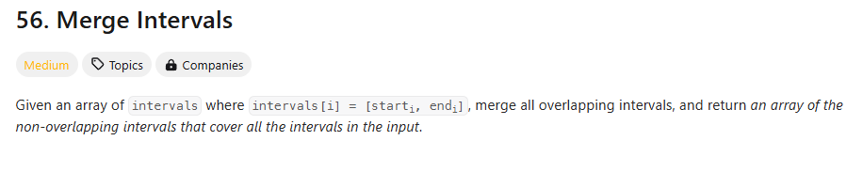
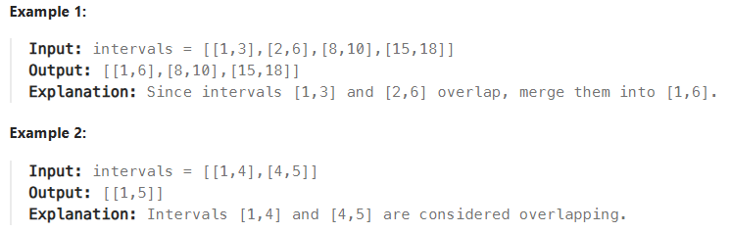
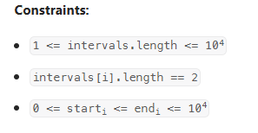
Problem Definition (1)

Slide 4
Solution (1)
0 1
0 1
0 1
0 1
[1,3] [2,6] [7,9] [8,10]
x
y
Overlap:
x[1] <= y [0]
x[0] <= y [0]
This case is overlapping!
merged
1 2 3 4 5 6 7 8 9 10

Slide 5
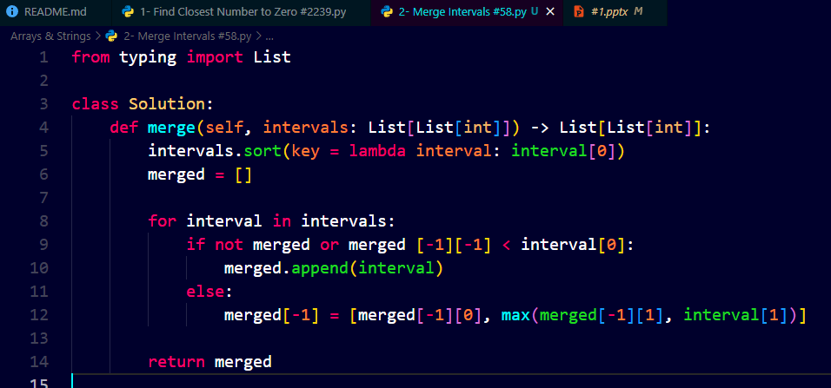
Solution (2)
lambda - to get any of them.
interval[0]: I started to sort from starting point
I merged all in a new list merged = [] -> merged[-1][-1] is to check previus interval in merged list

Slide 6
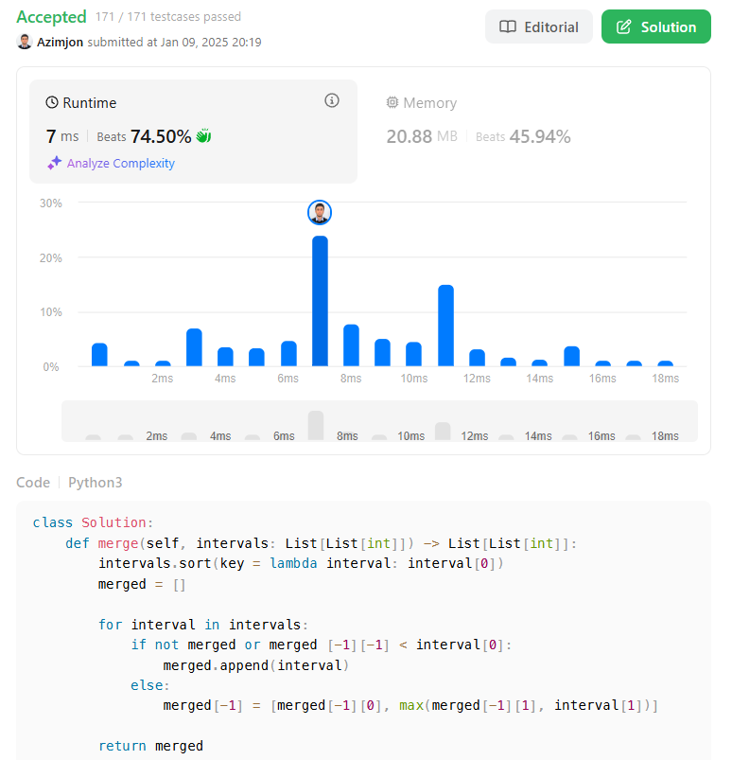
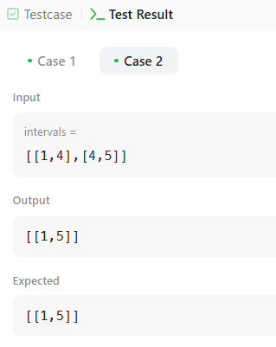
Solution (3)

Slide 7
What I have learned
Arrays:
I learnt to merge arrays without overlapping
And I got how to sorting arrays on interval
I used append() to store all selected intervals in a merged list
The merged list (merged = []) stores at most n intervals in the worst case.
so , this is total O(n).

Slide 8
Questions and Answers

Slide 9
Greetings

